Slide 1
MACHINE LEARNING
WIA1004/WAES1102
WEEK 9

Slide 2
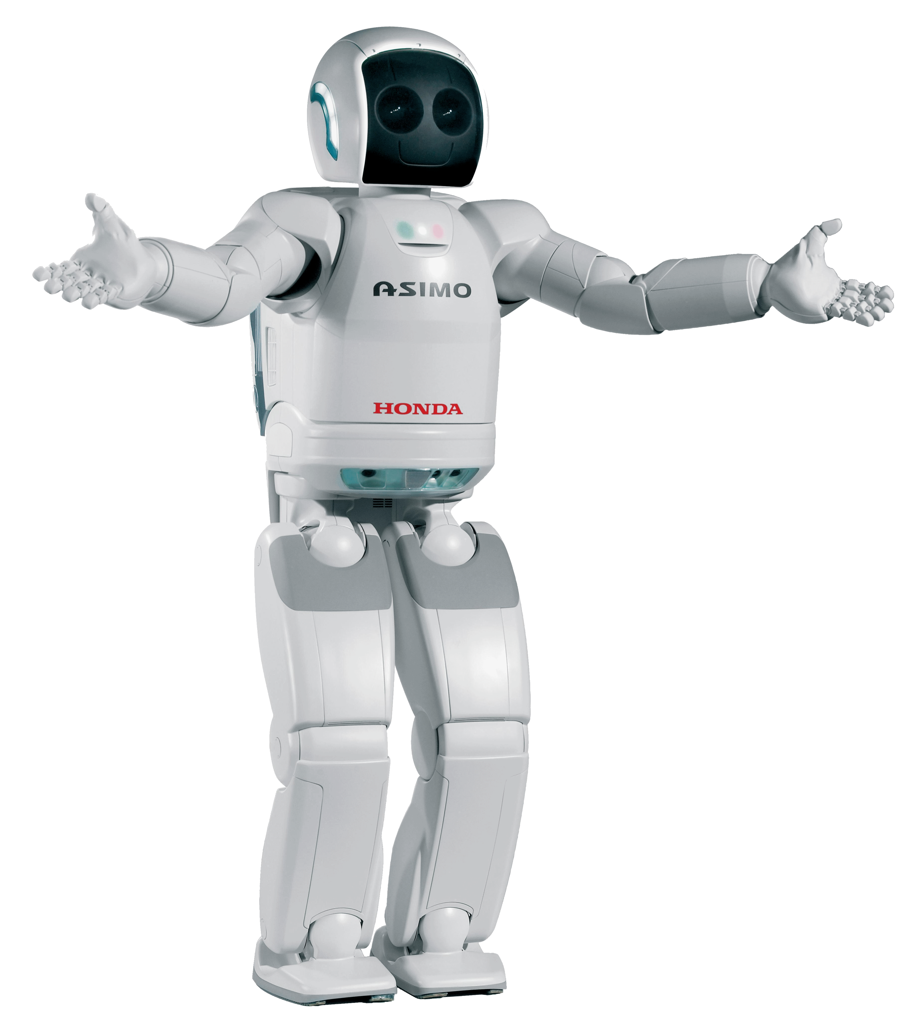


WHAT IS MACHINE LEARNING
data
Learn from experience
Learn from experience
Follow instructions

Slide 3
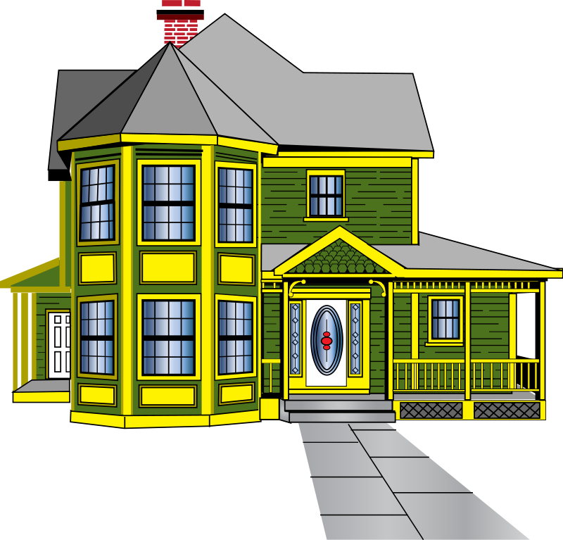

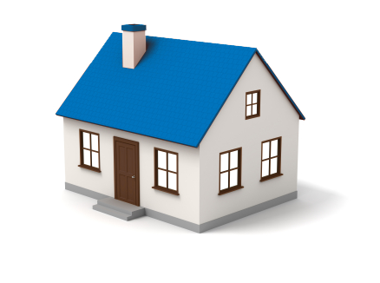

Price of a house
RM 70,000
RM 160,000

Slide 4

Linear Regression
Quiz: What’s the best
estimate for the price
of the house?
RM 80,000
RM120,000
RM190,000
20
16
Price (RM 10,000)
15
12
10
7
5
Size of the house (ft. squared)

Slide 5
Linear Regression
Error:

Slide 6
Linear Regression
Error:

Slide 7
Linear Regression
Error:

Slide 8

Linear Regression
Gradient descent
(Least squares)
Error:

Slide 9

Detecting spam emails

Slide 10

Detecting spam emails
“Cheap”
SPAM
NON SPAM

Slide 11
Detecting spam emails
“Cheap”
SPAM
NON SPAM

Slide 12
Detecting spam emails
“Cheap”
Quiz: If an email contains
the word “cheap”, what
is the probability of it
being spam?
40%
60%
80%
SPAM
NON SPAM
24
6

Slide 13
Detecting spam emails
“Cheap”
Quiz: If an email contains
The word “cheap”, what
is the probability of it
being spam?
40%
60%
80%
Conclusions:
If the email contains the word “cheap”,
the probability of it being spam is 80%
SPAM
NON SPAM
83.33%
10%

Slide 14

Detecting spam emails
“Cheap”
“Cheap” → 80%
40%
60%
80%
Quiz: If an email contains
The word “cheap”, what
is the probability of it
being spam?
Spelling mistake → 70%
Missing title → 95%
Conclusions:
If the email contains the word “cheap”,
the probability of it being spam is 80%
Etc…

Slide 15
Naïve bayes algorithm
“Cheap” → 80%
40%
60%
80%
Quiz: If an email contains
The word “cheap”, what
is the probability of it
being spam?
Spelling mistake → 70%
Missing title → 95%
Conclusions:
If the email contains the word “cheap”,
the probability of it being spam is 80%
Etc…

Slide 16



Recommending apps
Gender | Age | App
F | 15
F | 25
M | 32
F | 40
M | 12
M | 14
Quiz: Between Gender and Age, which
one seems more decisive for predicting
what app will the users download?
Gender
Age

Slide 17
Recommending apps
Gender | Age | App
F | 15
F | 25
M | 32
F | 40
M | 12
M | 14
Quiz: Between Gender and Age, which
one seems more decisive for predicting
what app will the users download?
Gender
Age

Slide 18
Recommending apps
Gender | Age | App
F | 15
F | 25
M | 32
F | 40
M | 12
M | 14
Quiz: Between Gender and Age, which
one seems more decisive for predicting
what app will the users download?
Gender
Age

Slide 19

Recommending apps
Age
<20 >=20
Gender | Age | App
F | 15
F | 25
M | 32
F | 40
M | 12
M | 14

Slide 20

Recommending apps
Age
<20 >=20
Gender | Age | App
F | 25
M | 32
F | 40
Gender
F M

Slide 21
Decision tree
Gender | Age | App
F | 15
F | 25
M | 32
F | 40
M | 12
M | 14
Age
<20 >=20
Gender
F M

Slide 22



Acceptance at a university
Test
Grades

Slide 23



Acceptance at a university
Test
Grades
Student 1
Test : 9/10
Grades : 8/10
Student 2
Test : 3/10
Grades : 4/10
Student 3
Test : 7/10
Grades : 6/10

Slide 24


Acceptance at a university
10
Student 3
Test : 7/10
Grades : 6/10
9
8
Grades
7
Quiz: Does the student
get Accepted?
Yes
No
6
5
4
3
2
1
1
2
3
4
5
6
7
8
9
10
Test

Slide 25
LOGISTIC REGRESSION
10
Student 3
Test : 7/10
Grades : 6/10
9
8
Grades
7
Quiz: Does the student
get Accepted?
Yes
No
6
5
4
3
2
1
1
2
3
4
5
6
7
8
9
10
Test

Slide 26
LOGISTIC REGRESSION
Errors: 2
Gradient descent

Slide 27
LOGISTIC REGRESSION
Errors: 1
Gradient descent

Slide 28
LOGISTIC REGRESSION
Errors: 0
Gradient descent
Log-loss function

Slide 29
Acceptance at a university
10
Student 4
Test : 9/10
Grades : 2/10
9
8
Grades
7
6
5
4
3
2
1
1
2
3
4
5
6
7
8
9
10
Test

Slide 30
Acceptance at a university
10
9
8
Grades
7
6
Gradient descent
5
4
3
2
1
1
2
3
4
5
6
7
8
9
10
Test

Slide 31
Neural network

Slide 32
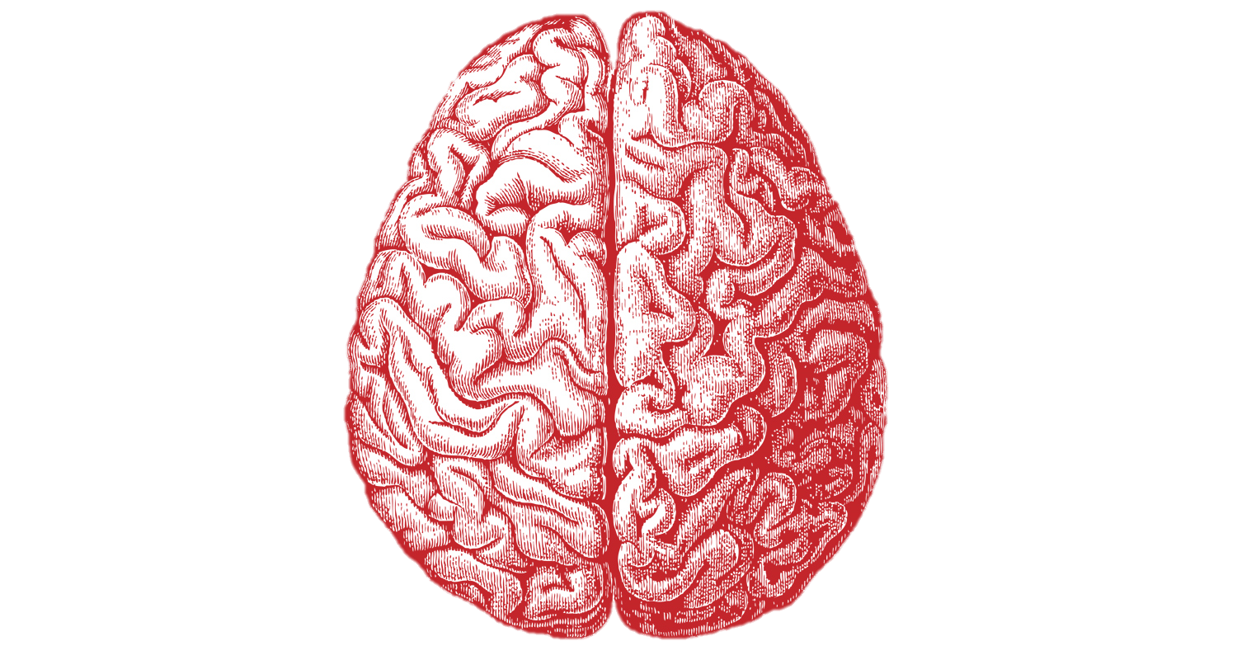
Neural network

Slide 33

Logistic Regression and neural network
Logistic Regression
Neural Network

Slide 34

Cutting data with style
Quiz:
Which one is a better line?
Yellow
Purple

Slide 35
Cutting data with style
Support vector machines
Gradient descent
LINEAR OPTIMIZATION

Slide 36

Support vector machines (svm)

Slide 37
Summary
Linear Regression
Decision Tree
Naïve Bayes
Neural Network
Support Vector Machine
Logistic Regression

